Slide 1

RescueNow
Connecting You to Immediate First-Aid
Industry / Inhouse Project : 2024-25
Review - I
Team Members :
Eshan Vijay (D12C - 19)
Yash Jha (D12C - 33)
Sumeet Janyani (D12C - 32)
Rahul Dudani (D12C - 18)
Project Mentor : Mrs. Lifna C. S
Assistant Professor, CMPN
Group Number : 29

Slide 2
Content
Introduction to Project
Lacuna in the existing systems
Problem Definition
Literature Survey
Methodology employed
Hardware, Software, tools and the constraints
Block Diagram
Modular Diagram
Next Work Plan
Conclusion
References

Slide 3
Introduction to Project
In the event of a traffic accident, immediate and effective response is crucial for ensuring the best possible outcomes for victims. However, significant delays often occur due to various factors, including the lack of instant accident reporting, the difficulty in identifying the nearest suitable medical facilities, and the challenges in coordinating emergency services. These delays can be detrimental, sometimes resulting in loss of life or worsening of injuries.
RescueNow is a mobile application designed to address these critical issues by providing a streamlined platform for accident reporting and emergency response. The application empowers passersby to quickly and efficiently report accidents, assess the severity, and automatically notify the nearest hospitals equipped to handle the situation. By facilitating real-time communication and coordination among all stakeholders, including casualty teams, hospitals, family members, and law enforcement, RescueNow aims to minimize response times and optimize medical care for accident victims.
Through RescueNow, we aim to improve the overall efficiency of accident management and ensure that victims receive timely and appropriate medical attention and ultimately save lives.

Slide 4

Introducing
RescueNow : Connecting You to Immediate First-Aid
Accidents shouldn't end lives; they should spark a chain of rescue. With RescueNow, you're the start of that chain.

Slide 5
Lacuna in the existing system
Here are some potential gaps (lacunae) in existing systems related to accident reporting and emergency response that RescueNow addresses:
Delayed Reporting: Traditional systems often rely on manual or delayed reporting of accidents, leading to significant delays in response times. RescueNow allows for immediate reporting, minimizing delays and speeding up the response process.
Fragmented Communication: In many cases, communication between different emergency services (police, hospitals, ambulance services) is not well-coordinated, resulting in confusion and slower response times. RescueNow provides a unified platform that facilitates seamless communication among all stakeholders.
Lack of Real-Time Location Data: Current systems may struggle with pinpointing the exact location of an accident, leading to delays in locating victims. RescueNow leverages GPS technology to provide real-time location data, ensuring that emergency services can reach the accident site quickly.

Slide 6
4. Inconsistent Severity Assessment: There is often no standardized method for assessing the severity of an accident in real-time, which can lead to under or overestimation of the required resources. RescueNow includes features for severity assessment, enabling more accurate and appropriate responses.
5. Difficulty in Identifying Nearest Medical Facilities: Identifying the nearest hospital equipped to handle the specific injuries sustained in an accident can be challenging, leading to delays in treatment. RescueNow automatically identifies and notifies the nearest suitable hospitals.
6. Limited Involvement of Bystanders: Many bystanders may not know how to effectively report an accident or may be hesitant to get involved. RescueNow simplifies the reporting process, empowering passersby to take immediate action without hesitation.
7. Inadequate Family Notification Systems: Current systems may not have a streamlined process for notifying the family members of accident victims, leading to delays in communication during critical moments. RescueNow includes a feature for automatic notification of family members, ensuring they are informed promptly.
These gaps highlight the need for an integrated solution like RescueNow to enhance the efficiency and effectiveness of accident management and emergency response.

Slide 7

Problem Definition
In the event of traffic accidents, the current emergency response systems are often hindered by delayed reporting, fragmented communication, and inefficient coordination among emergency services. These delays, coupled with challenges in accurately assessing the severity of accidents and identifying the nearest suitable medical facilities, result in slower response times and, in some cases, preventable loss of life. There is a critical need for a more efficient, real-time, and user-friendly system that empowers bystanders to quickly report accidents, facilitates seamless communication between all relevant stakeholders, and ensures that accident victims receive timely and appropriate medical attention.
To address these issues, we propose RescueNow, a mobile application designed to streamline the process of accident reporting and enhance the efficiency of emergency medical responses. RescueNow aims to ensure that victims receive timely and appropriate medical care by facilitating immediate accident reporting, identifying the nearest suitable hospitals, and enabling real-time coordination among all stakeholders involved in the rescue operation.

Slide 8
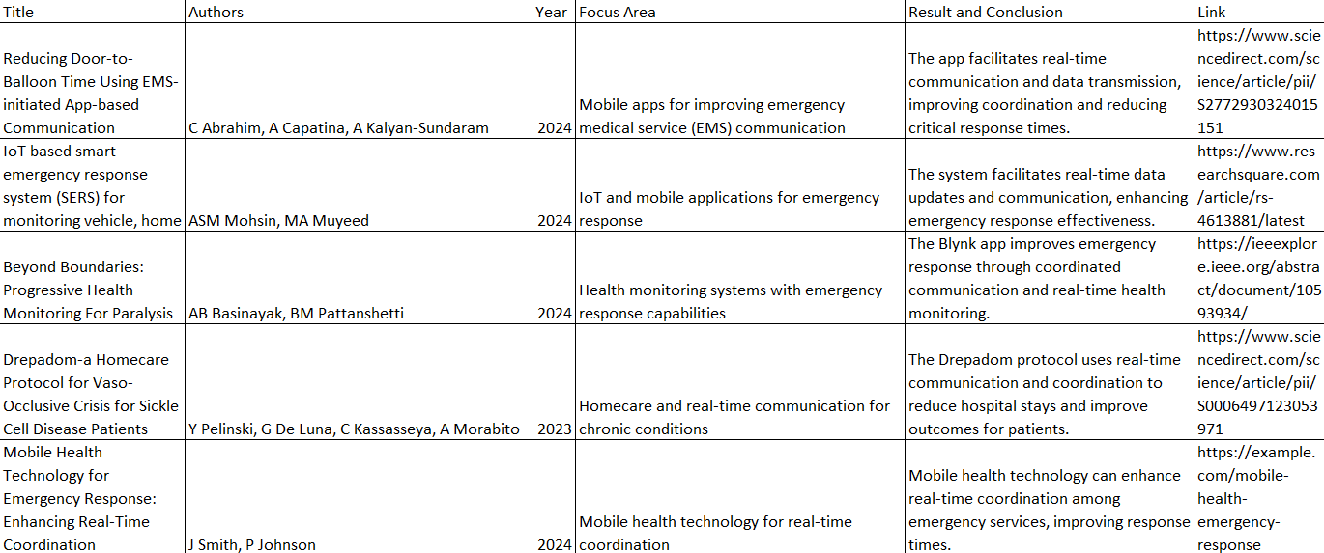
Literature Survey
Table 1 : Paper Review

Slide 9
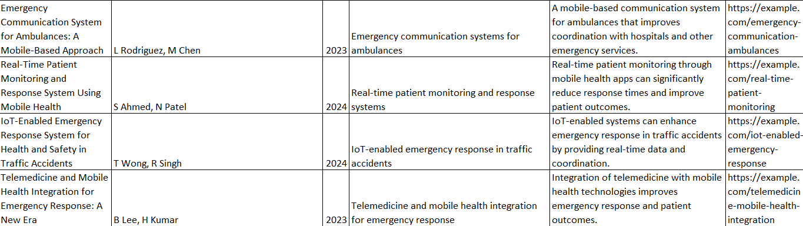
Literature Survey
Table 2 : Paper Review

Slide 10
Methodology Employed
The methodology for developing RescueNow involves several key stages:
Requirement Analysis: Gathering detailed requirements from stakeholders, including passersby, hospitals, casualty teams, and law enforcement.
System Design: Design the architecture of the application, including frontend, backend, and database components.
Development:
Frontend Development Implementing features for accident reporting, severity rating, and location tracking.
Backend Development: Developing logic for identifying suitable hospitals and managing incident timelines.
Database Setup: Designing and implementing the database schema for storing accident reports, hospital information, and vitals records.
4) Integration: Connecting frontend components with backend services and database.
5) Testing: Performing integration testing to ensure all parts work together as expected. Gathering user feedback and performing user acceptance testing.
6) Deployment: Publishing the mobile application on Google Play Store and Apple App Store.
7) Maintenance and Updates: Monitoring and Updating the app based on user feedback and technological advancements.

Slide 11
Hardware, Software, Tools and constraint
Hardware Requirements
1. For Development:
Development Machines:
Processor: Intel i5 or higher (or equivalent AMD processor)
RAM: 8 GB or more
Storage: 256 GB SSD or higher
Mobile Devices: Smartphones and tablets for testing (iOS and Android)
Software Requirements :
Frontend Development : Flutter.
Backend Development : Node.js and Firebase.
Database Management System : MongoDB.
Tools:
Version Control: Git and Github for source code management.

Slide 12
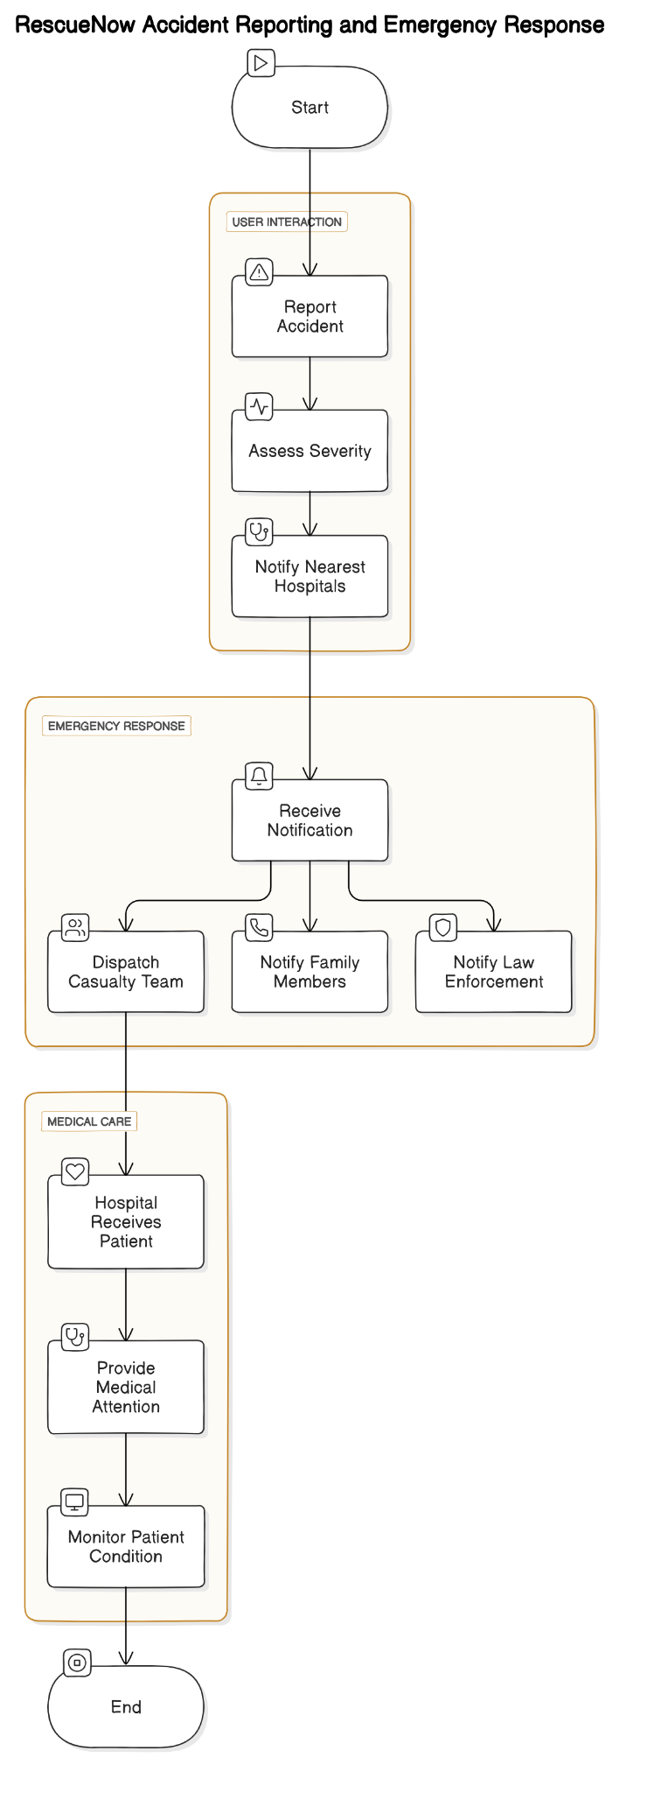
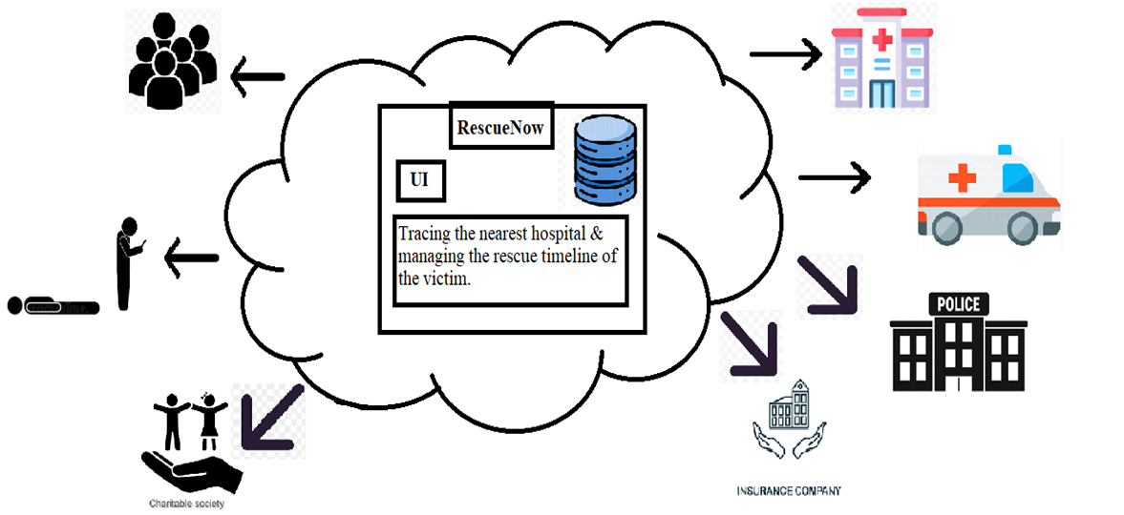
Block / Modular Diagram

Slide 13
Next Work Plan
1) Learn Dart language and develop an attractive frontend using Flutter.
2) Begin backend development with Node.js, focusing on core API functionalities and database integration.
3) Integrate the mobile app with the backend and implement location services.
4) Complete the notification system and conduct initial testing.
5) Establish communication with control rooms for notifying police in charge.
6) Perform comprehensive testing, fix bugs, and finalize documentation.
7) Deploy the application.

Slide 14
Conclusion
RescueNow represents a significant advancement in emergency response management, addressing critical challenges in accident reporting and medical intervention. By integrating real-time data collection, efficient hospital notification, and streamlined communication among all stakeholders, the application aims to enhance the overall effectiveness of emergency responses.
The proposed solution leverages modern technology to facilitate rapid accident reporting, accurate assessment of medical needs, and timely coordination with hospitals and casualty teams. This approach not only improves response times but also ensures that victims receive appropriate and immediate medical care, potentially saving lives and mitigating the impact of injuries.
RescueNow is designed with a focus on usability, performance, and security, ensuring that it meets the needs of users in high-pressure situations while maintaining the confidentiality and integrity of sensitive data. Through rigorous testing and evaluation, the application will be refined to meet the highest standards of reliability and effectiveness.
In summary, RescueNow has the potential to transform emergency response operations, providing a comprehensive solution that integrates technology and coordination to improve outcomes in critical situations. By continuously evaluating and optimizing the application, we aim to achieve a significant positive impact on emergency response efficiency and victim care.

Slide 15
References
[1] A. B. Author, Book Title, 2nd ed. New York, NY, USA: Wiley, 2019.
[2] J. K. Author, "Research paper title," IEEE Trans. on Ind. Informatics, vol. 5, no. 4, pp. 123-129, Nov. 2020.
[3] S. M. Author and R. S. Author, "Paper title," in Proc. IEEE Conf. on Decision and Control, Miami, FL, USA, Dec. 2018, pp. 456-461.
[4] R. Author, "How to reference in IEEE format," Example Website. [Online]. Available: http://www.example.com. [Accessed: Aug. 23, 2024].
[5] A. B. Author, "Article title," Tech Review, Mar. 23, 2024. [Online]. Available: http://www.techreview.com/article/1234. [Accessed: Aug. 23, 2024].

Slide 16

Thank You!!

